Slide 1
Object Oriented Programming – Week 9
Archie Powell
November 2023

Slide 2
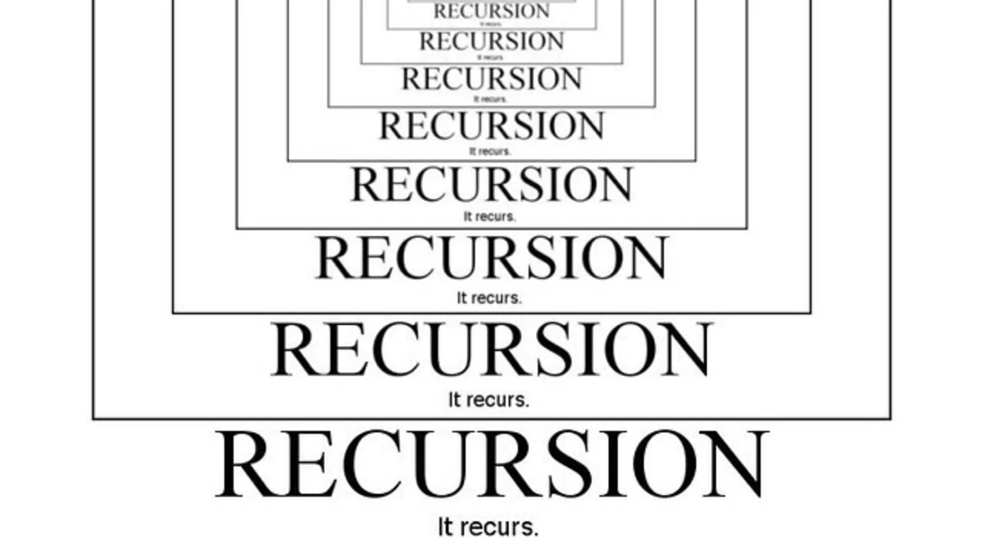

Slide 3



What is Recursion?
Recursion is a method where the solution depends on solutions to smaller instances of the same problem.[1]
Fractal
[1]Graham, Ronald; Knuth, Donald; Patashnik, Oren (1990). "1: Recurrent Problems". Concrete Mathematics. ISBN 0-201-55802-5.

Slide 4
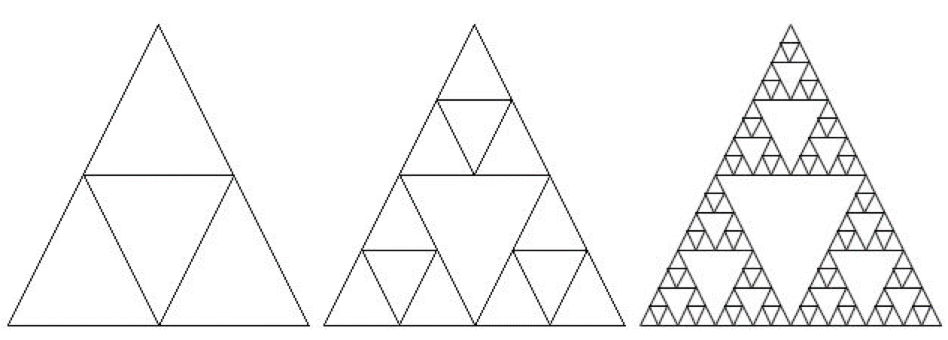


What is Recursion?
Learning to think recursively is the equivalent of learning to look for big things that are made from smaller but exactly the same type of things!

Slide 5


Suppose you are in a queue, and want to find out how many people are in front of you?
Any person in front of you?
…
0
0+1
1+1
2+1
With “God View”
Without “God View”
(People can only communicate with those who standing directly in front and behind them)
Iteration
Start counting until you reach the beginning of the queue.
Step 1. Ask people in front of you and see if there is another person in front of them.
Step 2. If there isn’t, return the answer “0”. Otherwise, ask that person to repeat Step 1 and wait for a response.
Step 3. Once a person receive a response, add 1 and pass the answer to those standing behind them until the response reaches you.
Recursion

Slide 6
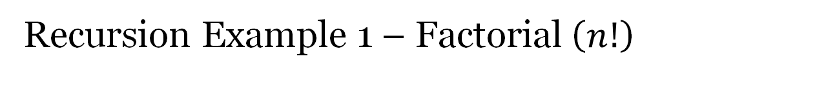
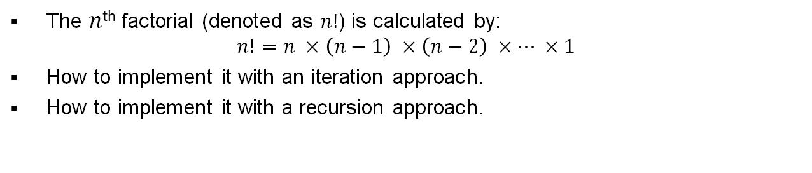
Recursion Example 1 – Factorial ($n!$)
The $n$^{th} factorial (denoted as $n!$) is calculated by:
$$n!=n ×\left(n−1\right) ×\left(n−2\right) ×… ×1$$
How to implement it with an iteration approach.
How to implement it with a recursion approach.
public long RecursionApproach(int _number) {
return (_number == 1) ? 1 : _number * RecursionApproach(_number - 1);
}
public long IterationApproach(int _number) {
long result = 1;
for (int i = _number; i > 1; i--) {
result *= i;
}
return result;
}
if (_number == 1) {
return 1;
}else{
return _number * RecursionApproach(_number -1);
}

Slide 7
public class Main {
private static final int FACTORIAL_NUMBER = 4;
public static void main(String[] args) {
Factorial myFactorial = new Factorial();
long value2 = myFactorial.RecursionApproach(FACTORIAL_NUMBER);
}
}
4
return 4 * 6
4
public long RecursionApproach(int _number) {
return (_number == 1) ? 1 : _number * RecursionApproach(_number - 1);
}
4
3
3
return 3 * 2
Recursive case
public long RecursionApproach(int _number) {
return (_number == 1) ? 1 : _number * RecursionApproach(_number - 1);
}
3
2
2
return 2 * 1
public long RecursionApproach(int _number) {
return (_number == 1) ? 1 : _number * RecursionApproach(_number - 1);
}
Base case – where our recursion will directly provide results without breaking it again into sub-problem(s).
2
1
1
return 1
public long RecursionApproach(int _number) {
return (_number == 1) ? 1 : _number * RecursionApproach(_number - 1);
}
1

Slide 8
Recursion Example 1 = Factorial
Last In First Out (LIFO)
At the kernel/JVM level, information about the recursion operation, such as the current state of the control flow and local variables, is stored in the call stack.
When the recursion is called, a memory space will be allocated to it on the stack.
A new stack will be created during the recursion process, and will be put on the top of the call stack.
Additional memories will be allocated to each new stack created during the recursion, and will be used to store a different copy of local variables within these stacks.
When the base case is reached, the function returns the value to its caller, and the associated memory will be de-allocated.
RA(2)
RA(3)
RA(4)
RA(1)
Order of the function call
Order of value return
Call Stack

Slide 9
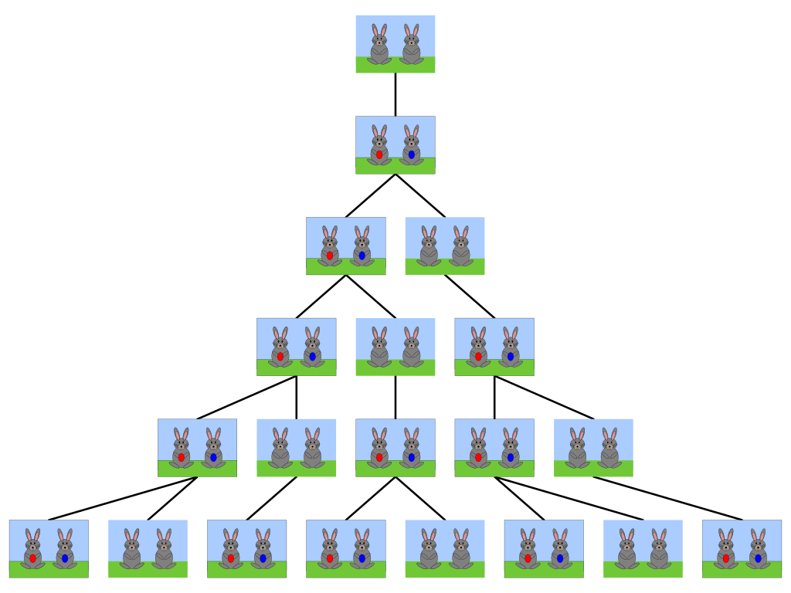

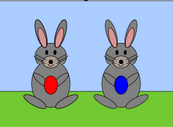
Recursion Example 2 – Fibonacci Sequence Rabbit
Month 1
Baby Rabbits
Month 2
Adult Rabbits
Month 3
Rule No.1 – Rabbits never die.
Rule No.2 – Baby rabbits need a month to grow up.
Month 4
Rule No.3 – Adult rabbits always produce one new pair (one male, one female).
Month 5
Month 6
Image Source: https://en.wikipedia.org/wiki/File:FibonacciRabbit.svg

Slide 10
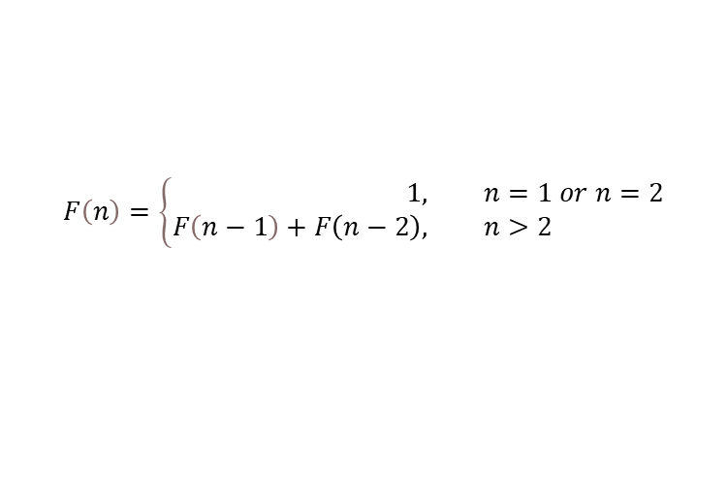
Recursion Example 2 – Fibonacci Sequence
Fibonacci Sequence:
1, 1, 2, 3, 5, 8, 13, 21, 34, 55, 89, 144, ...
Calculation formula:
$$F\left(n\right)=\left\{\begin{aligned}1, &n=1 or n=2 \\ F\left(n−1\right)+F\left(n−2\right), &n>2\end{aligned}\right.$$
Recursion Approach
Iteration Approach
public long RecursionApproach(int _index) {
return (_index == 1 || _index == 2) ? 1 : RecursionApproach(_index - 1) + RecursionApproach(_index - 2);
}
public long IterationApproach(int _index) {
long[] valueArray = new long[_index];
valueArray[0] = valueArray[1] = 1;
for (int i = 2; i < _index; i++) {
valueArray[i] = valueArray[i - 1] + valueArray[i - 2];
}
return valueArray[_index - 1];
}

Slide 11
Iteration VS Recursion
Recursion is such an elegant approach, should we use it whenever we can?
  Let’s compare the performance against Recursion and Iteration.
  When _index is small, there is not much difference between recursion and iteration. However, when _index is big, the difference is HUGE!
  Why?

Slide 12

Iteration VS Recursion
RA(6)
RA(4)
RA(3)
RA(2)
RA(2)
RA(1)
RA(5)
RA(3)
RA(2)
RA(1)
RA(4)
RA(2)
RA(3)
RA(2)
RA(1)
$$Time Complexity=O\left(2^{n}\right)$$
Time complexity is a function describing the amount of time an algorithm takes in terms of the amount of input to the algorithm.

Slide 13
Iteration VS Recursion
Both iteration and recursion repeatedly execute the code, but there are some differences:
Iteration
Iteration applies to a set of instructions/statements.
An iteration terminates when the loop condition fails.
An iteration does not generate multiple stacks, so in general it is faster and use less memory than recursion.
Iteration makes the coder longer.
Recursion
Recursion is a process and always applies to a function/method.
A recursion terminates when reaches the BASE CASE.
Due to the use the stack, recursion is normally slower and use more memory than iteration.
Recursion makes the code more compact.

Slide 14
Best Practice
Be Smart! -- Balance the code size and the performance, and use recursion carefully.
When recursion is necessary, use tail-recursion instead of normal/head recursion.
  Tail-recursion: where the recursive call is the LAST operation executed by the function/method.

Slide 15
Tail Recursion
public class Main {
private static final int FIBONACCI_NUMBER = 4;
public static void main(String[] args) {
Fibonacci myFibnacci = new Factorial();
long value2 = myFibnacci.ImprovedRA(FIBONACCI_NUMBER,1,1);
}
}
4
return 3
4
public long ImprovedRA(int _index, long _first, long _second) {
return (_index <= 1) ? _first : ImprovedRA(_index - 1, _second, _first + _second);
}
3
1
2
3
1
2
return 3
public long ImprovedRA(int _index, long _first, long _second) {
return (_index <= 1) ? _first : ImprovedRA(_index - 1, _second, _first + _second);
}
2
2
3
2
2
3
return 3
public long ImprovedRA(int _index, long _first, long _second) {
return (_index <= 1) ? _first : ImprovedRA(_index - 1, _second, _first + _second);
}
1
3
5
1
3
5
return 3
public long ImprovedRA(int _index, long _first, long _second) {
return (_index <= 1) ? _first : ImprovedRA(_index - 1, _second, _first + _second);
}
1

Slide 16

Q & A

